Slide 1

Common Prayers to be Known

Slide 2
Prayers to be known by phase
Age Phase | 4-5 (EYFS) | 5-7 (KS1) | 7-9 (Lower KS2) | 9-11 (Upper KS2) | 11 – 14 (KS3)
Prayers | The Sign of the Cross The Lords Prayer Hail Mary | Morning Offering - KS1 Grace before meals – KS1 Grace after meals – KS1 Prayer at the end of the day – KS1 Glory Be | Morning Offering – KS2 Grace before meals - KS2 Grace after meals – KS2 Prayer at the end of the day – KS2 The Apostles’ Creed An Act of Contrition Angel of God The Prayer of St Richard of Chichester Act of Faith Act of Hope Act of Love | The Rosary The Magnificat Come, Holy Spirit | The Benedictus The Angelus Hail Holy Queen The Memorare Jesus, Mary and Joseph, I give you Eternal Rest Diocesan Prayer for Vocations
Notes:
Press ctrl + the link to go to the prayer within the PP

Slide 3
EYFS

Slide 4
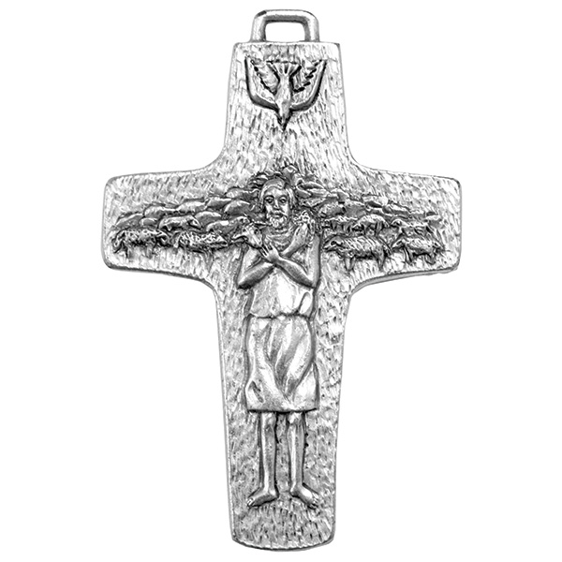
Sign of the Cross
In the name of the Father,
and of the Son,
and of the Holy Spirit.
Amen.
Notes:
The sign of the cross is both an action and a statement of faith. A physical reminder of our redemption in the cross and an expression of faith in the Trinity

Slide 5

The Lords Prayer
Our Father, who art in heaven,
hallowed be thy name.
Thy kingdom come.
Thy will be done on earth, as it is in heaven.
Give us this day our daily bread,
and forgive us our trespasses,
as we forgive those who trespass against us.
And lead us not into temptation,
but deliver us from evil.
Amen.
Notes:
The Lord’s Prayer ‘is truly the summary of the whole of the Gospel’. (CCC 2761.)

Slide 6
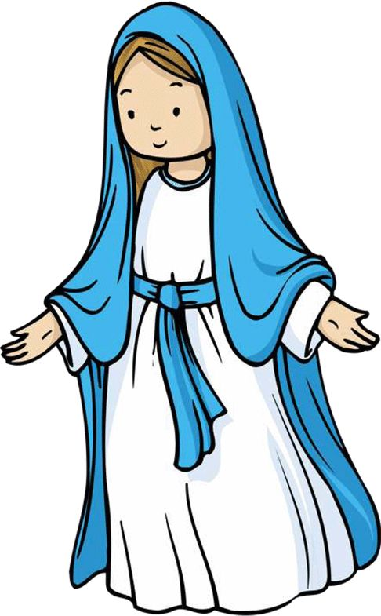
Hail Mary
Hail Mary, full of grace,
the Lord is with thee:
blessed art thou among women,
and blessed is the fruit of thy womb, Jesus.
Holy Mary, Mother of God,
pray for us sinners,
now and at the hour of our death.
Amen.
Notes:
The first part of the Hail Mary is biblical, drawn from Gabriel’s greeting to Mary at the Annunciation and Elizabeth’s greeting at the Visitation. The second part of the prayer has its origins in 15th-century Italy

Slide 7
KS1

Slide 8

Morning Prayer – KS1
Father in heaven, you love me,
you are with me night and day.
I want to love you always
in all I do and say.
I’ll try to please you, Father,
bless me through the day.
Amen.

Slide 9
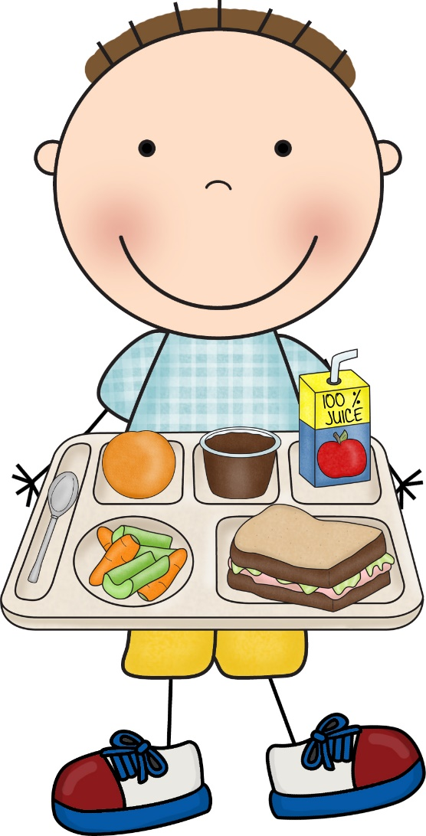
Grace Before Meals – KS1
Bless us, O God, as we sit together.
Bless the food we eat today.
Bless the hands that made the food.
Bless us, O God.
Amen.

Slide 10
Grace after meals – KS1
Thank you, God, for the food we have eaten.
Thank you, God, for all our friends.
Thank you, God, for everything,
Thank you God.
Amen.

Slide 11
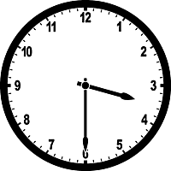
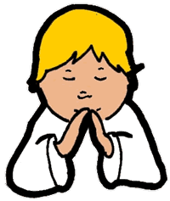
Prayer at the end of the day – KS1
God our Father, I come to say
thank you for your love today.
Thank you for my family
and all the friends you give to me.
Guard me in the dark of night
and in the morning send your light.
Amen.

Slide 12
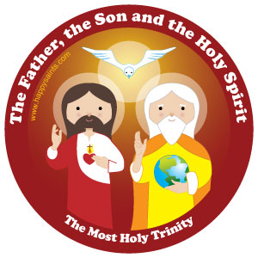
Glory Be
Glory be to the Father,
and to the Son,
and to the Holy Spirit,
as it was in the beginning,
is now, and ever shall be,
world without end.
Amen.

Slide 13
LKS2

Slide 14
Morning Prayer – KS2
O Jesus,
through the most pure heart of Mary,
I offer you all my prayers,
thoughts, works and sufferings of this day
for all the intentions of your most Sacred heart.

Slide 15
Grace Before Meals – KS2
Bless us, O Lord, and these your gifts
which we are about to receive from your bounty.
Through Christ our Lord.
Amen

Slide 16
Grace after meals – KS2
We give you thanks, Almighty God,
for all your benefits,
who live and reign, world without end.
Amen

Slide 17
Prayer at the end of the day – KS2
Lord Jesus Christ,
As we come to the end of this school day,
Help us to reflect and to pray:
For the difficulties I have known, I ask for your help.
For the blessings I have received; I thank you.
May I seek to be an instrument of your peace in my home today.
Each day is a gift.
May I look forward to a new start tomorrow.
May the journey of my life be an experience of your love,
your compassion,
your forgiveness
and your peace
Amen.

Slide 18
Apostles creed
I believe in God,
the Father almighty
Creator of heaven and earth,
And in Jesus Christ, his only Son, our Lord,
(At the words that follow up to and including the Virgin Mary, all bow)
who was conceived by the Holy Spirit,
Born of the Virgin Mary
Suffered under Pontius Pilate,
was crucified, died and was buried;
Notes:
Based on baptismal documents of the 8th century but related to texts of an earlier origin.

Slide 19
Apostles creed
he descended into hell;
on the third day he rose again from the dead;
he ascended into heaven,
and is seated at the right hand of God the Father almighty;
From there he will come to judge the living and the dead.
Notes:
Based on baptismal documents of the 8th century but related to texts of an earlier origin.

Slide 20
Apostles creed
I believe in the Holy Spirit,
the holy catholic Church,
the communion of saints,
the forgiveness of sins,
the resurrection of the body,
and life everlasting.
Amen
Notes:
Based on baptismal documents of the 8th century but related to texts of an earlier origin.

Slide 21
An Act of Contrition
O my God,
bcause you are so good,
I am very sorry that I have sinned against you,
and with the help of your grace
I will not sin again
Notes:
One of the forms of the Penitent’s Prayer of Sorrow found in the Rite of Penance.

Slide 22

Prayer to the Guardian Angel
Angel of God, my guardian dear,
to whom God's love commits me here,
ever this day be at my side,
to light and guard, to rule and guide.
Amen.
Notes:
The prayer is based on one by Reginald of Canterbury in the early 12th century.

Slide 23
Prayer of St. Richard of Chichester
Day by day,
O dear Lord,
three things I pray:
to see you more clearly,
love you more dearly,
follow you more nearly,
day by day,
by day, by day.
Amen.

Slide 24
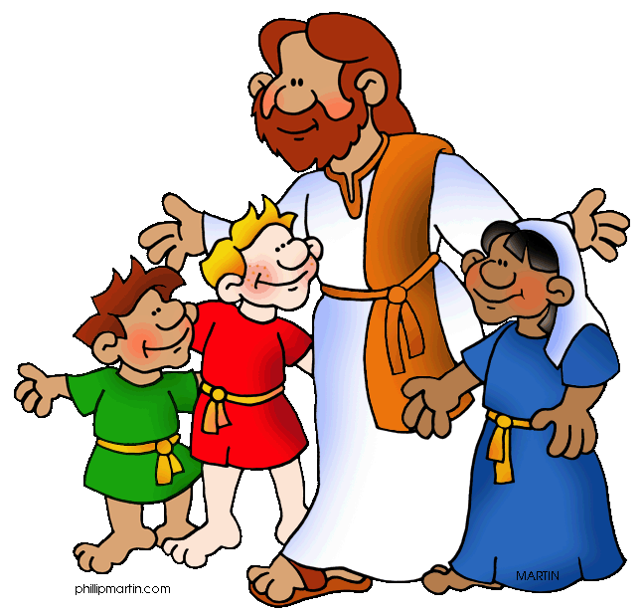
Act of Faith, Hope and Love
Jesus, I believe in you.
Jesus, I hope in you.
Jesus, I love you.

Slide 25


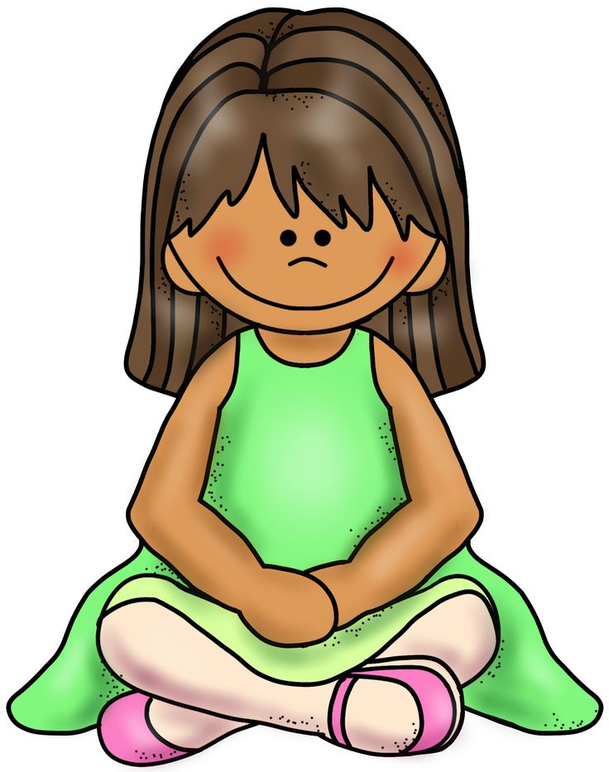
Act of Faith
My God, I believe in you
and all your Church teaches,
because you have said it
and your word is true.

Slide 26

Act of Hope
My God, I hope in you,
for grace and for glory,
because of your promises,
your mercy and power.

Slide 27

Act of Love
My God, because you are so good,
I love you with all my heart,
And for your sake,
I love your neighbour as myself

Slide 28
UKS2

Slide 29
The Rosary
For each mystery or decade, one Our Father, ten Hail Marys and the Glory be is recited.
The Joyful Mysteries (Recited Monday and Saturday)
The Mysteries of Light (Recited Thursday)
The Sorrowful Mysteries (Recited Tuesday and Friday)
The Glorious Mysteries (Recited Wednesday and Sunday)
Notes:
The Joyful Mysteries (Recited Monday and Saturday) The Annunciation (Luke 1:26–38) The Visitation (Luke 1:39–45) The Nativity (Luke 2:1–7) The Presentation in the Temple (Luke 2:22–35) The Finding in the Temple (Luke 2:41–52) The Mysteries of Light (Recited Thursday) The Baptism of Jesus (Matthew 3:13–17) The Wedding Feast of Cana (John 2:1–12) The Proclamation of the Kingdom, with the call to Conversion (Mark 1:14–15; 2:3–12) The Transfiguration (Luke 9:28–36) The Institution of the Eucharist (Matthew 26:26–29) The Sorrowful Mysteries (Recited Tuesday and Friday) The Agony in the Garden (Mark 14:32–42) The Scourging at the Pillar (Matthew 27:15–26) The Crowning with Thorns (Matthew 27:27–31) The Carrying of the Cross (John 19:15–17; Luke 23:27–32) The Crucifixion (Luke 23:33–38, 44–46) The Glorious Mysteries (Recited Wednesday and Sunday) The Resurrection (Matthew 28:1–8) The Ascension (Acts 1:6–11) The Descent of the Holy Spirit (Acts 2:1-12) The Assumption (1 Thessalonians 4:13–19) The Coronation of Mary Queen of Heaven and Earth (Revelation 12:1; 14:1–5; Isaiah 6:1–3)

Slide 30
Prayer concluding the Rosary
V. Pray for us, O holy Mother of God.
R. That we may be made worthy of the promises of Christ.
Let us pray.
O God, whose only-begotten Son,
by his life, death and resurrection,
has purchased for us the rewards of eternal life,
grant, we beseech thee,
that meditating on these mysteries
of the most holy Rosary of the Blessed Virgin Mary,
we may imitate what they contain
and obtain what they promise,
through the same Christ our Lord.
Amen

Slide 31
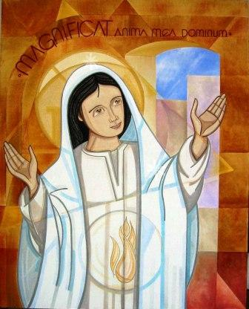
The Magnificat
My soul glorifies the Lord,
My spirit rejoices in God, my Saviour.
He looks on his servant in her lowliness;
henceforth all ages will call me blessed.
The Almighty works marvels for me.
Holy his name!
His mercy is from age to age,
on those who fear him.
Notes:
Mary’s song of praise was first sung to her cousin Elizabeth (Luke 1:46–55). It is sung daily at Evening Prayer

Slide 32
He puts forth his arm in strength
and scatters the proud-hearted.
He casts the mighty from their thrones
and raises the lowly.
He fills the starving with good things,
sends the rich away empty.
He protects Israel, his servant,
remembering his mercy,
the mercy promised to our fathers,
to Abraham and his sons for ever. Amen.

Slide 33

Prayer to the Holy Spirit
O Come, Holy Spirit,
fill the hearts of your faithful,
and kindle in them the fire of your love.
Send forth your Spirit and they shall be created.
And you shall renew the face of the earth.
O God, who has taught the hearts of the faithful
by the light of the Holy Spirit,
grant that by the gift of that same Spirit
we may be always truly wise
and ever rejoice in his consolation.
Amen.

Slide 34
KS3

Slide 35
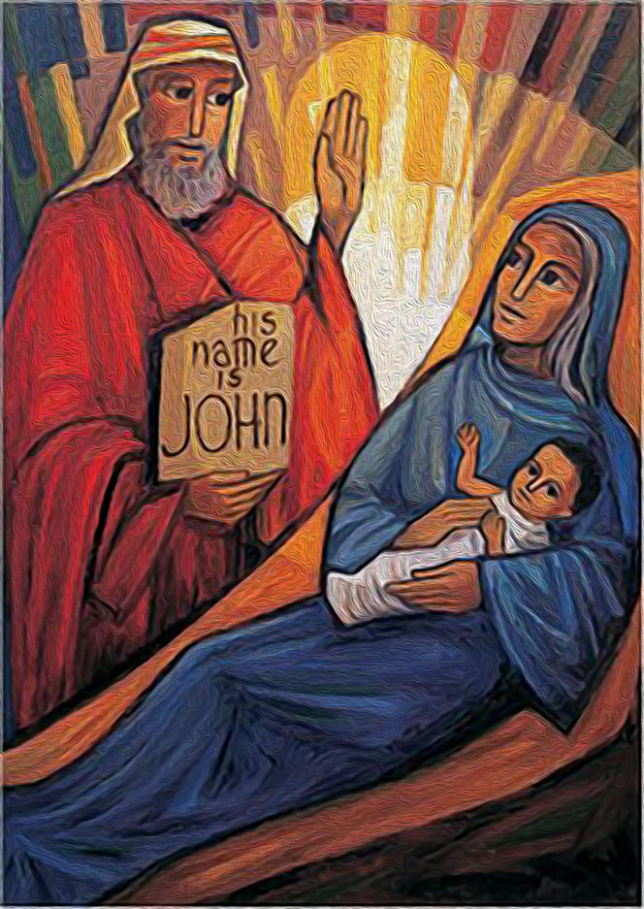
Benedictus
Blessed be the Lord, the God of Israel;
he has come to his people and set them free.
He has raised up for us a mighty saviour,
born of the house of his servant David.
Through his holy prophets he promised of old
That he would save us from our enemies,
From the hands of all who hate us.
Notes:
The Canticle of Zechariah, father of John the Baptist, is taken from Luke’s Gospel (Luke 1:68–79). It is sung daily at Morning Prayer.

Slide 36
He promised to show mercy to our fathers
and to remember his holy covenant.
This was the oath that he swore to our father Abraham:
To set us free from the hands of our enemies,
Free to worship him without fear,
Holy and righteous in his sight all the days of our life.

Slide 37
You, my child, shall be called the prophet of the Most High;
for you will go before the Lord to prepare his way,
to give his people knowledge of salvation
by the forgiveness of their sins.
In the tender compassion of our God
the dawn from on high shall break upon us,
to shine on those who dwell in darkness and the shadow of death,
and to guide our feet into the way of peace.
Glory be to the Father, and to the Son,
and to the Holy Spirit:
as it was in the beginning, is now,
and ever shall be, world without end. Amen.

Slide 38
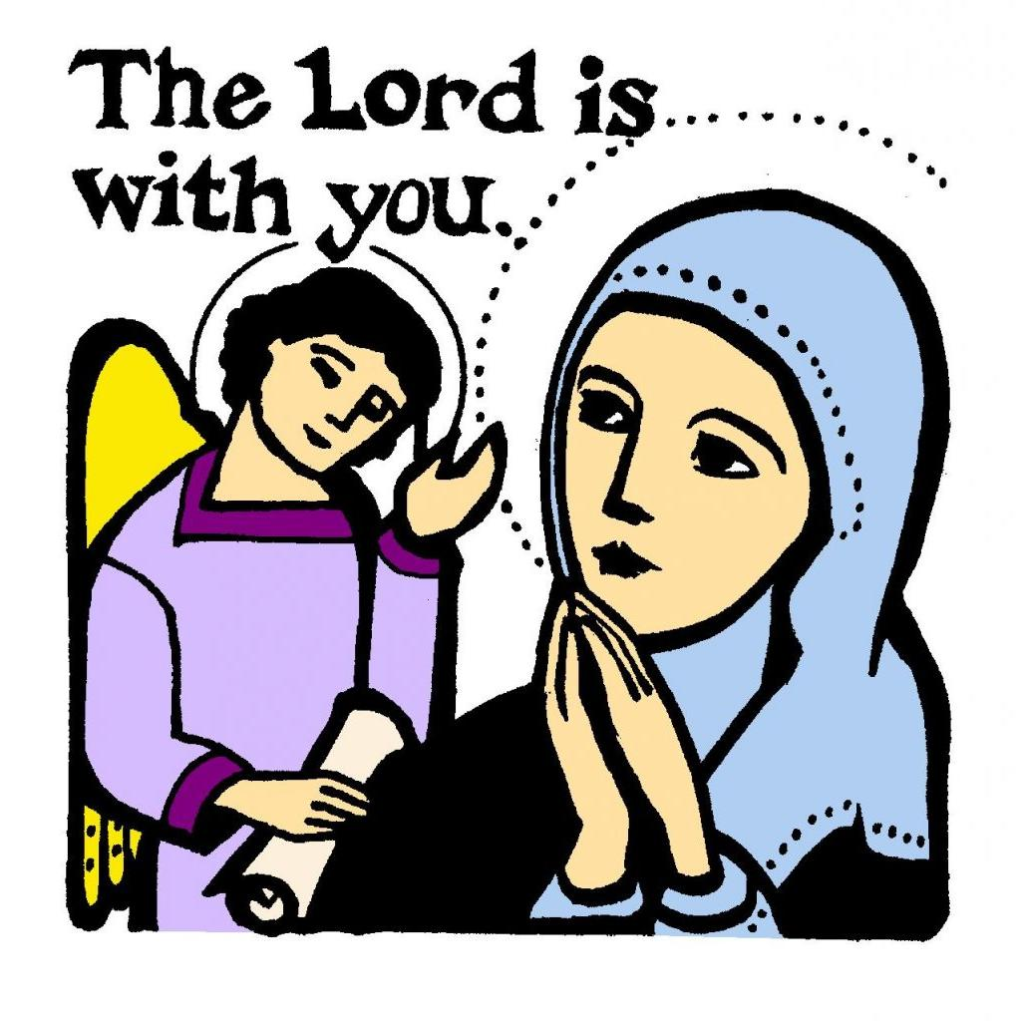
The Angelus
The Angel of the Lord declared to Mary: and she conceived of the Holy Spirit.
Hail Mary… Holy Mary…
Behold the handmaid of the Lord: be it done to me according to your word.
Hail Mary… Holy Mary…
And the Word was made flesh: and dwelt among us
Hail Mary… Holy Mary…
Pray for us, O holy Mother of God that we may be made worthy of the promises of Christ.

Slide 39
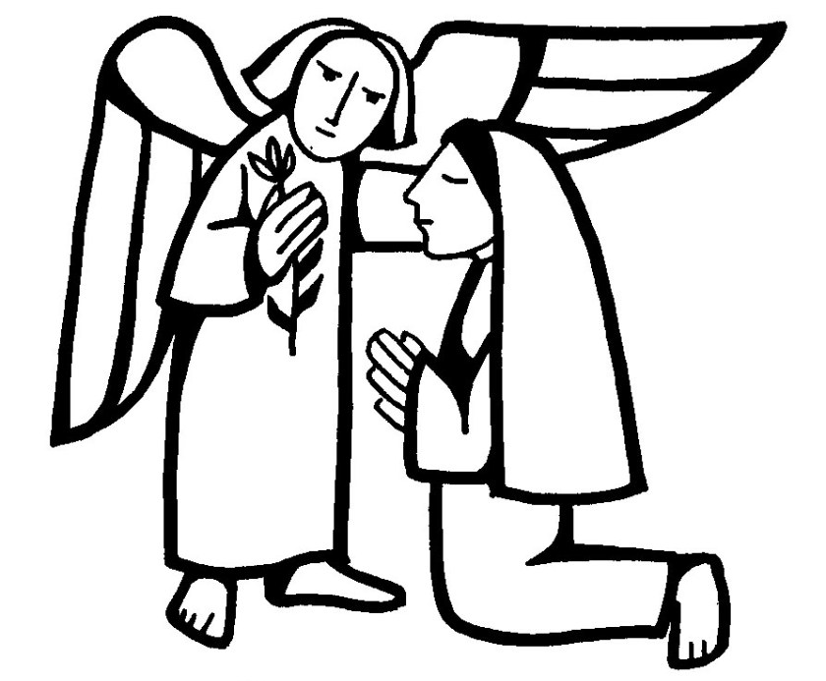
Let us pray:
Pour forth, we beseech you, O Lord,
your grace into our hearts,
that we to whom the incarnation of Christ, your Son,
was made known by the message of an angel,
may be brought by his passion and cross
to the glory of his resurrection,
through Christ our Lord. Amen.

Slide 40
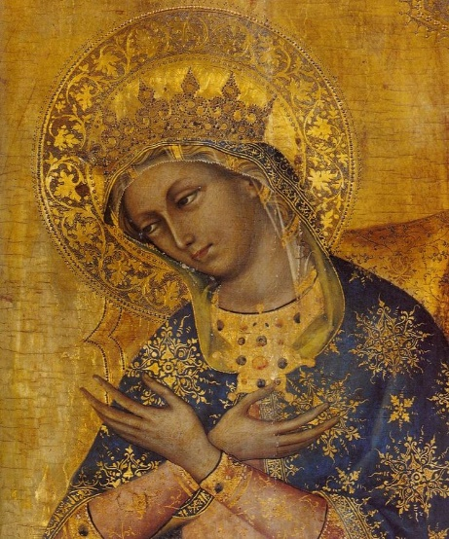
Hail Holy Queen (Salve Regina)
Hail, Holy Queen, Mother of Mercy;
Hail, our life, our sweetness and our hope!
To thee do we cry, poor banished children of Eve.
To thee do we send up our sighs,
mourning and weeping in this valley of tears!
Turn, then, most gracious Advocate,
thine eyes of mercy toward us,
and after this, our exile,
show unto us the blessed fruit of thy womb, Jesus.
O clement, O loving,
O sweet Virgin Mary.
Notes:
The Salve Regina is one of the Marian Anthems sung at Night Prayer.

Slide 41
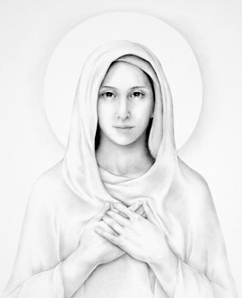
The Memorare
Remember, O most gracious Virgin Mary,
that never was it known
that anyone who fled to your protection,
implored your help or sought your intercession,
was left unaided.
Notes:
A 16th-century version of a longer 15th-century prayer.

Slide 42
Inspired with this confidence, I fly unto you,
O Virgin of virgins, my Mother.
To you I come, before you I stand,
sinful and sorrowful;
O Mother of the Word Incarnate,
despise not my petitions, but in your mercy
hear and answer me.
Amen.

Slide 43
Jesus, Mary and Joseph
Jesus, Mary and Joseph, I give you my heart and my soul.
Jesus, Mary and Joseph, assist me in my last agony.
Jesus, Mary and Joseph, may I breathe forth my soul in peace with you.

Slide 44
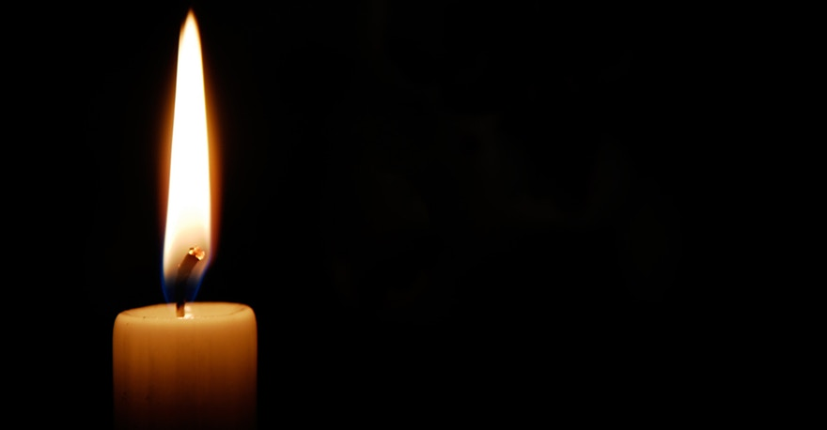
Eternal Rest
Eternal rest give unto them, O Lord,
and let perpetual light shine upon them.
May they rest in peace.
Amen.

Slide 45
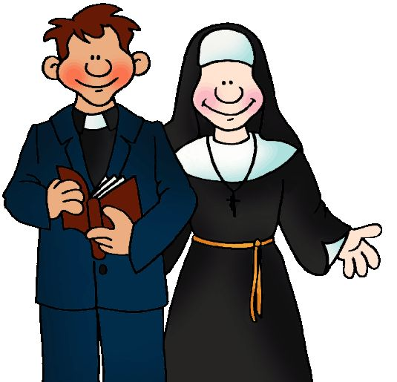
Diocesan Prayer for Vocations
Heavenly Father,
we ask you to send labourers
into your harvest.
Inspire, in the hearts of your people,
vocations to the priesthood, diaconate
and religious life.
Bless our families with a spirit of generosity,
so that those whom you call
have the courage to give themselves
to your Church in faith.
Through Christ our Lord.
Amen.

Slide 46
Additional
Prayers

Slide 47
Prayer of St. Francis
Lord, make me an instrument of your peace:
where there is hatred, let me sow love;
where there is injury, pardon;
where there is doubt, faith;
where there is despair, hope;
where there is darkness, light;
where there is sadness, joy.
Notes:
Please note, this prayer was written by an anonymous author.

Slide 48
O divine Master, grant that I may not so much seek
to be consoled as to console,
to be understood as to understand,
to be loved as to love.
For it is in giving that we receive,
it is in pardoning that we are pardoned,
and it is in dying that we are born to eternal life.
Amen.

Slide 49
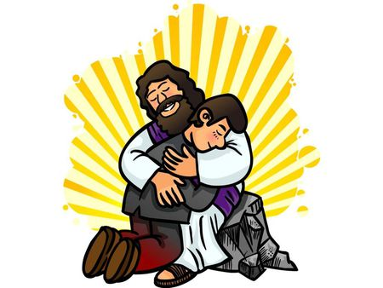
Act of Sorrow
O my God, I thank you for loving me.
I am sorry for all my sins:
for not loving others
and not loving you.
Help me to live like Jesus
and not sin again.
Amen.

Slide 50

Prayer of Thanksgiving after Communion
O Sacrament most holy!
O Sacrament divine!
All praise and all thanksgiving
be every moment thine.

Slide 51
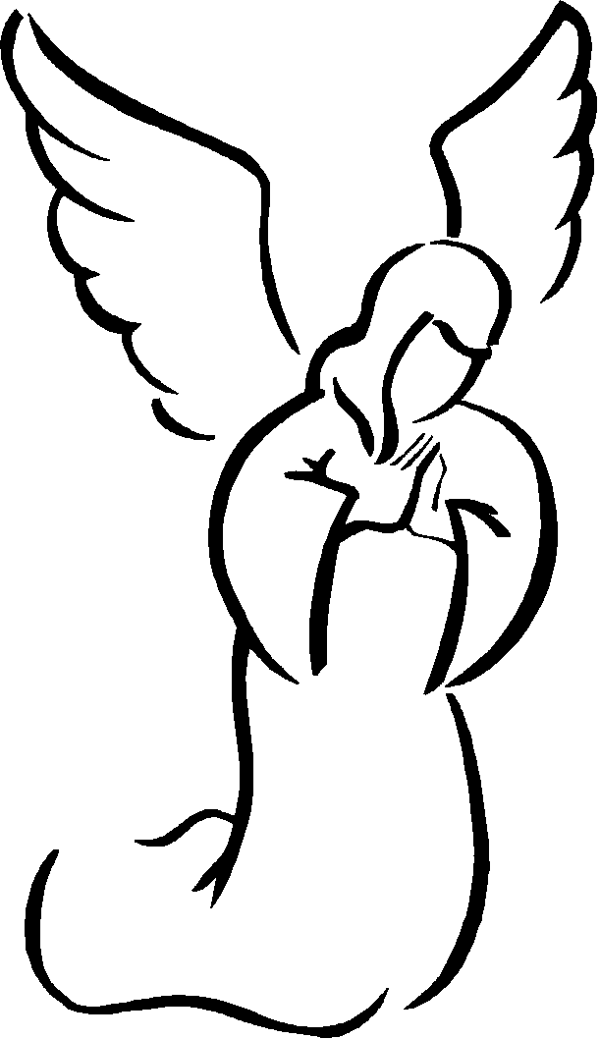
Prayer to the
Guardian Angel
Angel sent by God to guide me,
be my light and walk beside me;
be my guardian and protect me;
on the paths of life direct me.

Slide 52
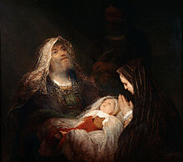
Nunc Dimittis
Now, Lord, you have kept your word:
let your servant go in peace.
With my own eyes I have seen the salvation
which you have prepared in the sight of every people:
a light to reveal you to the nations
and the glory of your people Israel.
Glory be to the Father and to the Son
and to the Holy Spirit,
as it was in the beginning, is now,
and ever shall be, world without end.
Amen.

Slide 53
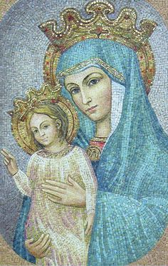
Regina Caeli
Queen of Heaven, rejoice. Alleluia!
For he whom you were made worthy to bear. Alleluia!
Has risen as he said. Alleluia!
Pray for us to our God. Alleluia!
Rejoice and be glad, O Virgin Mary. Alleluia!
For the Lord has risen indeed. Alleluia!
Let us pray;
God, who through the resurrection of your Son, our Lord Jesus Christ,
has made glad the whole world, grant us, we pray,
that through the intercession of the Virgin Mary, his mother,
we may attain the joys of everlasting life.
Through the same Christ our Lord.
Amen.

